Slide 1
Apple Inc. (AAPL) Historical Stock Market Analysis
Advanced Python for Data Analysis
AnalystLab Africa Internship – Week 6
Prepared by: Azeemah Sullayman

Slide 2
Project Overview
• Analyze five years of Apple stock data
• Data transformation using Pandas
• Time-series analysis
• Feature engineering
• Actionable insights

Slide 3
Dataset Overview
Source: Yahoo Finance
Period: Five Years
Features:
• Date
• Open
• High
• Low
• Close
• Adjusted Close
• Volume

Slide 4
Data Transformation
• Converted Date to datetime
• Daily Price Change
• Daily % Change
• High–Low Difference
• Year, Month & Day

Slide 5
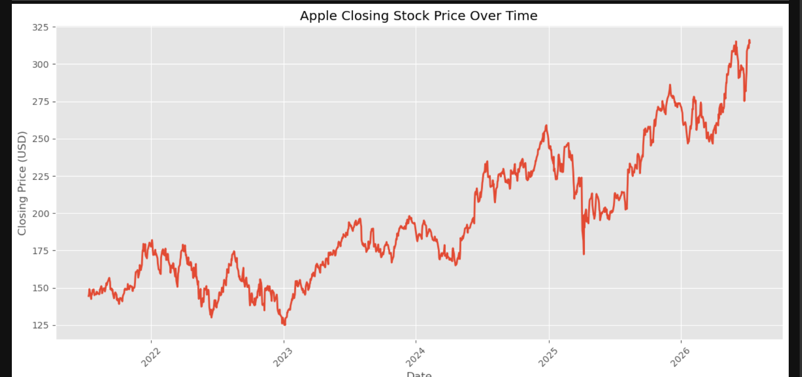
Closing Price Trend

Slide 6
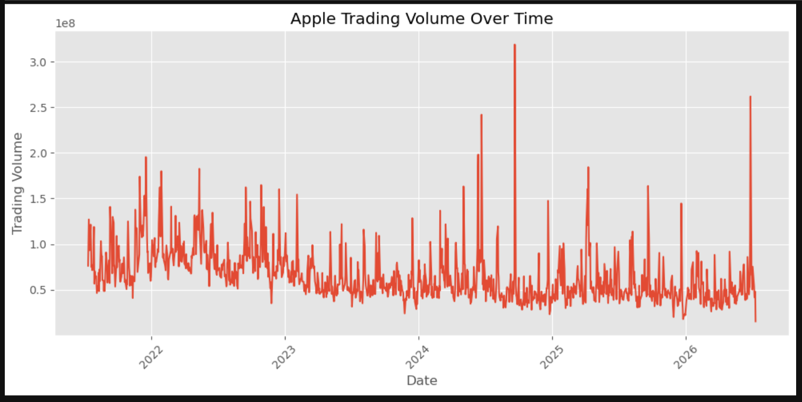
Trading Volume Trend
[INSERT SCREENSHOT HERE]

Slide 7
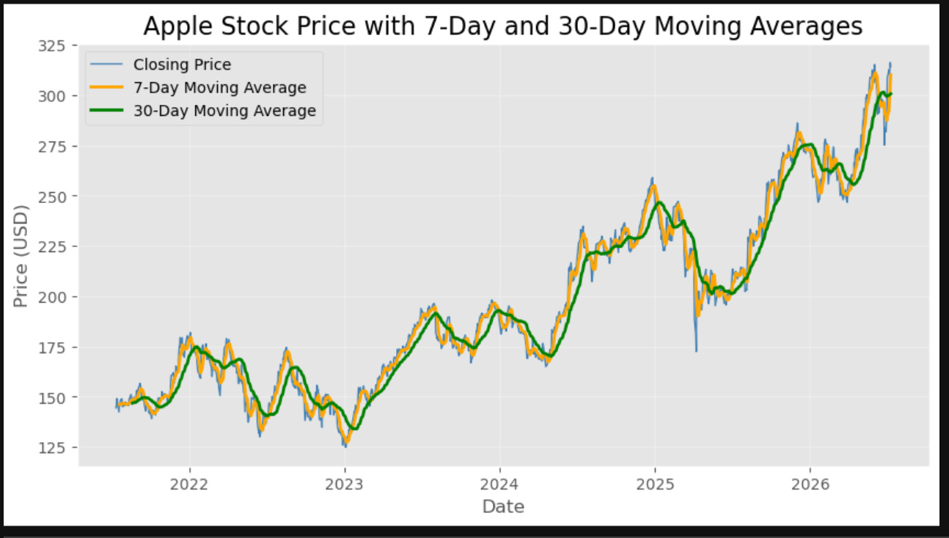
Moving Average Analysis

Slide 8
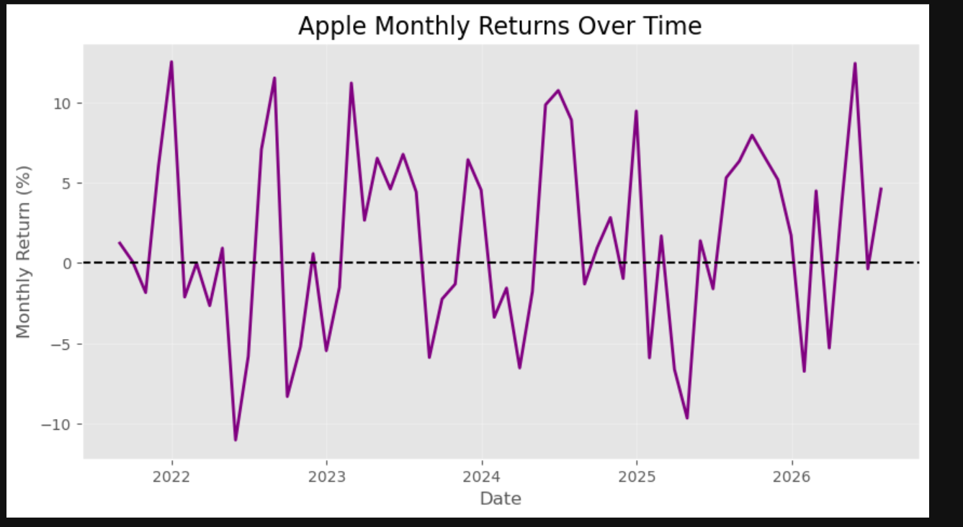
Monthly Returns Analysis
[INSERT SCREENSHOT HERE]

Slide 9
Feature Engineering
• Daily Price Change
• Daily % Change
• 7-Day MA
• 30-Day MA
• Daily Return
• Monthly Return
• Volatility

Slide 10
Key Findings
Average Closing Price: $196.61
Average Trading Volume: 65,084,442
Average Daily Return: 0.08%
Average 30-Day Volatility: 1.64%
Overall Stock Growth: 117.49%

Slide 11
Recommendations
• Monitor long-term trends
• Consider volatility
• Compare peer companies
• Combine with economic indicators

Slide 12
Conclusion
Advanced Python techniques successfully analyzed Apple's stock performance.
Overall Stock Growth: 117.49%
Thank You

